Slide 1
HR Analytics
Unveiling the Factors Behind Employees Attrition
Presented by:
Sara Ahmed

Slide 2
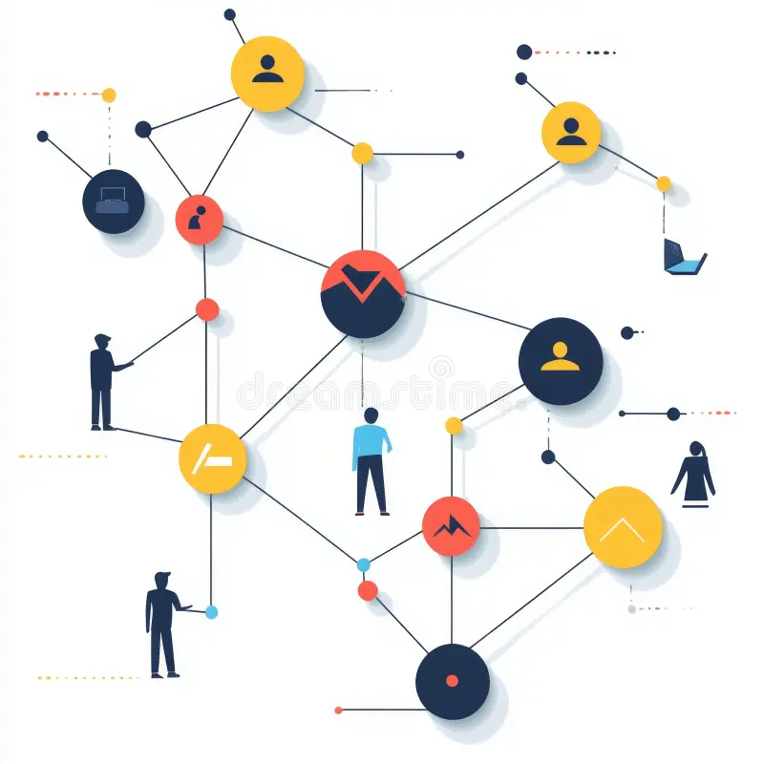
High employee turnover huts productivity and increases costs. This project analyzes HR data to identify why employees leave and predict attrition risks. We examine factors like job satisfaction, salary, promotions and work-life balance to help companies improve retention strategies.
Problem Description

Slide 3
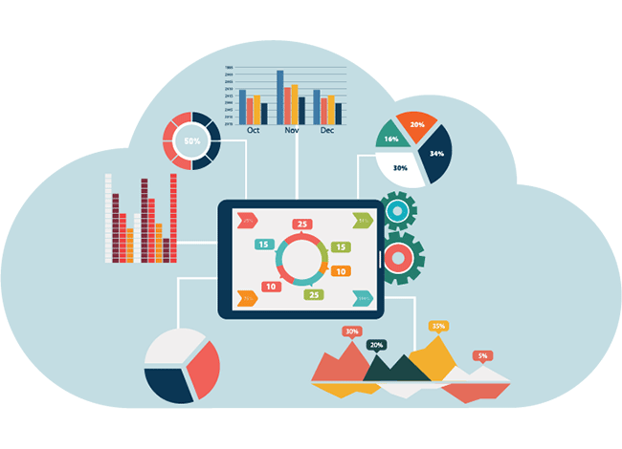
This data-driven approach enables HR to:
Identify at-risk employees early
Understand key attrition drivers
Improve engagement & policies
HR can develop targeted, evidence-based retention strategies.
Proposed Solution
‹#›

Slide 4
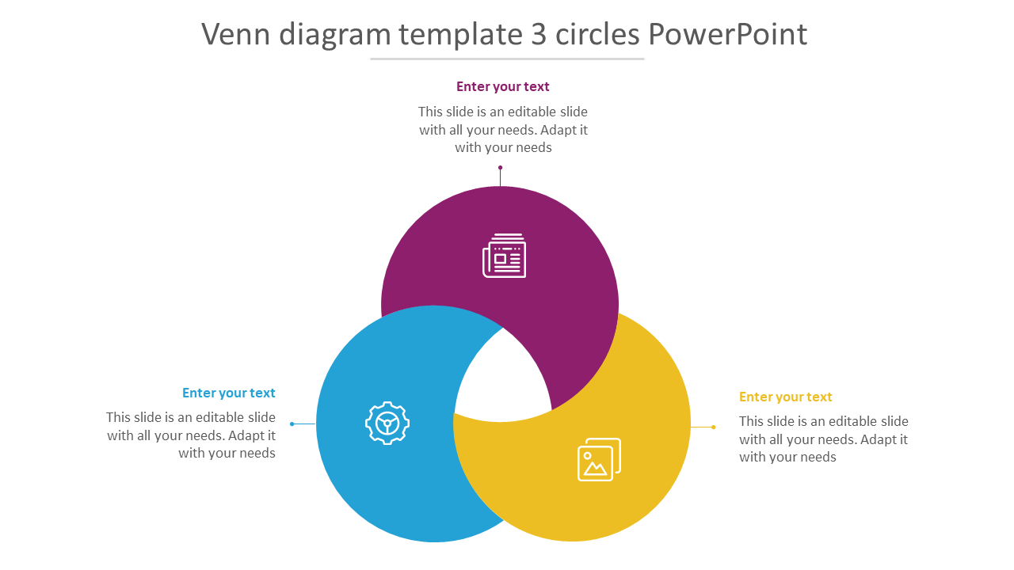
Monthly Income
End User
HR employee
Education Level
Job Level

Slide 5
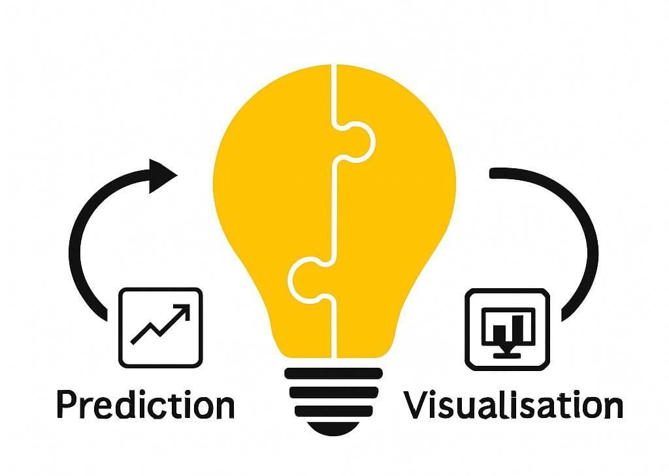

Slide 6

Data Structure
‹#›

Slide 7
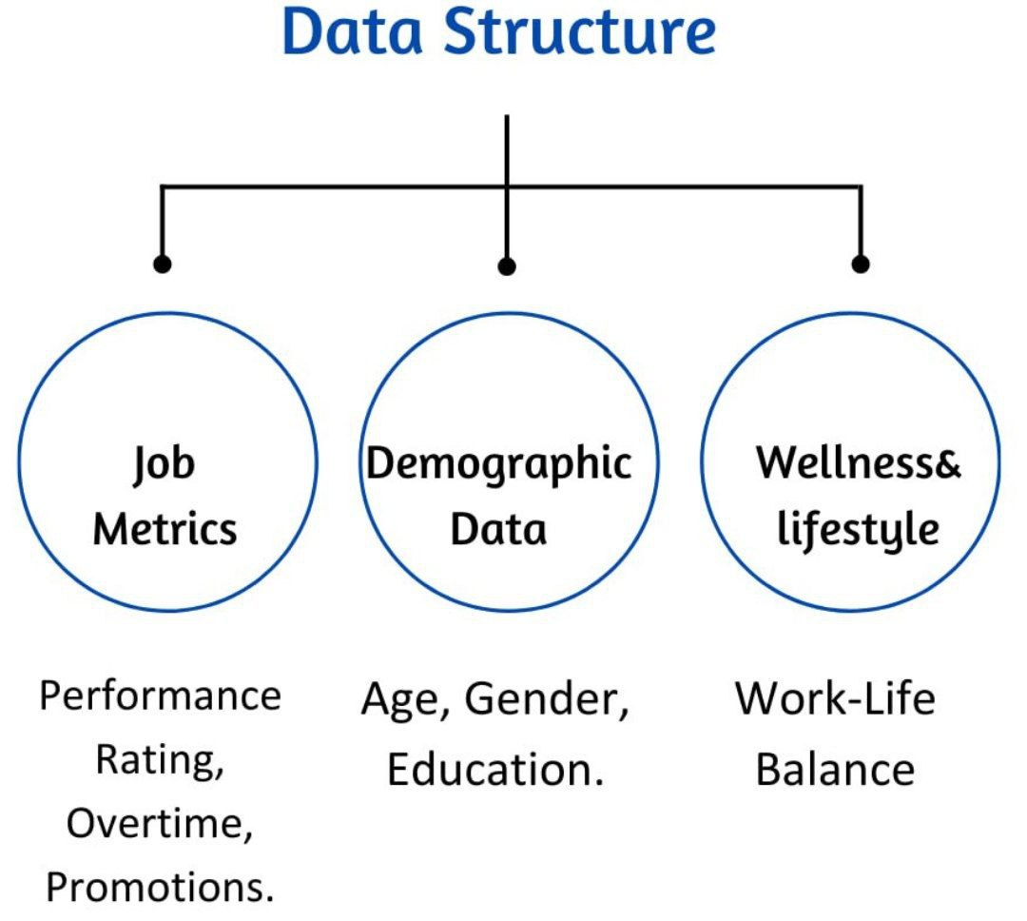
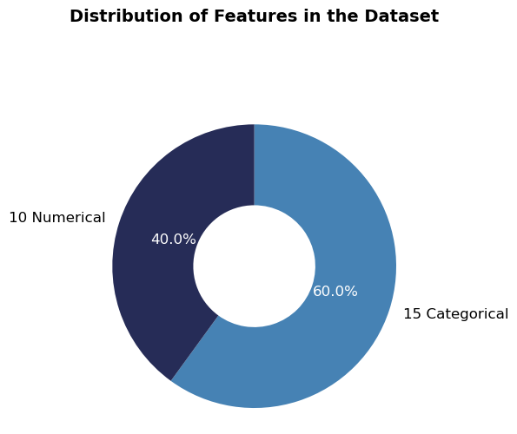
Data Overview
The dataset consists of 59,598 record

Slide 8
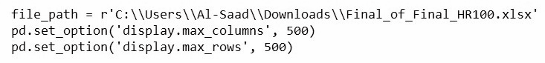
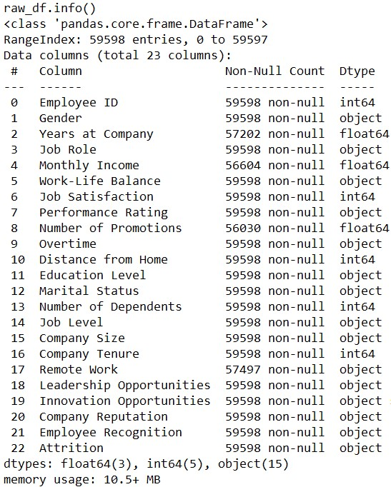
Data Importing
Data Information

Slide 9
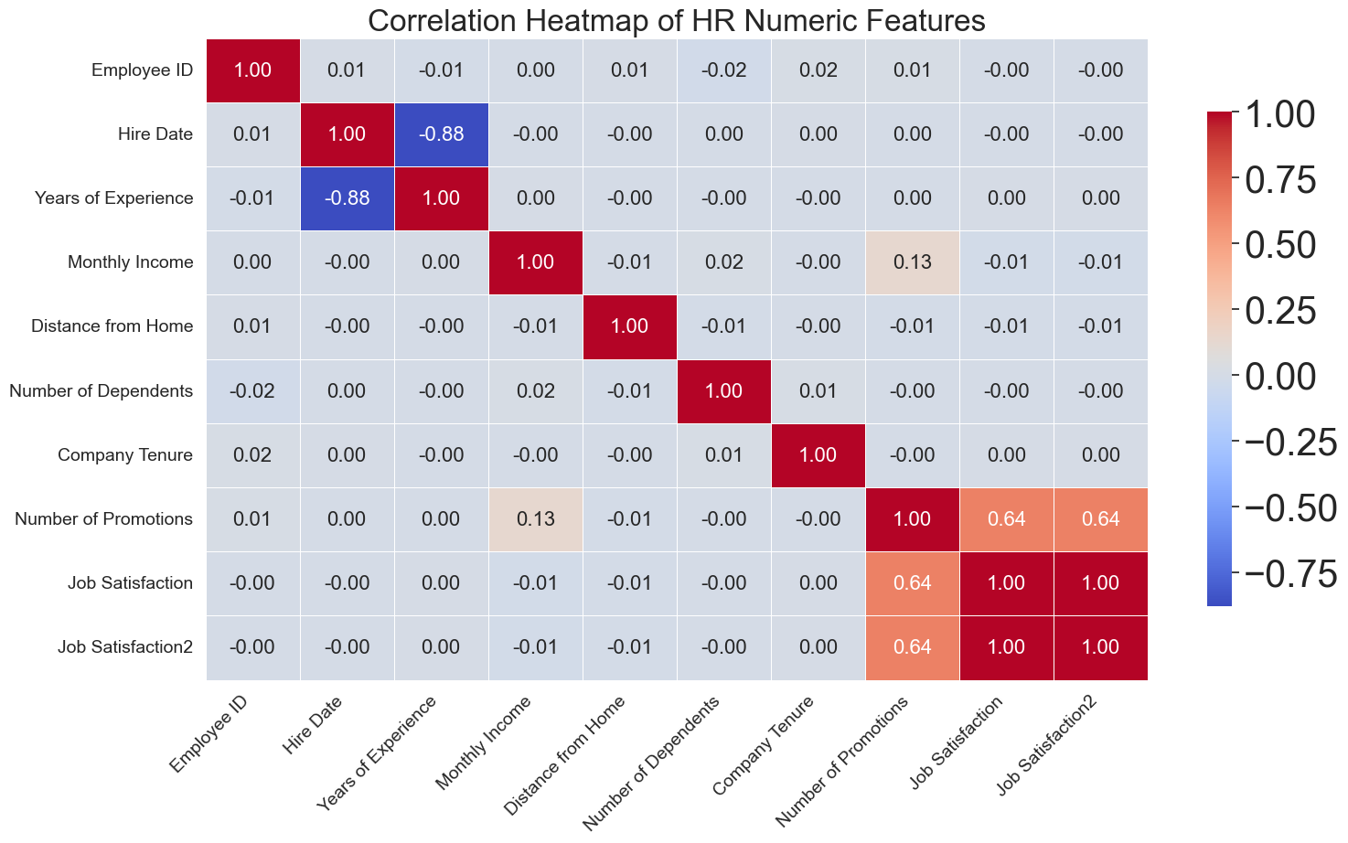
Relationships Between Data Points

Slide 10
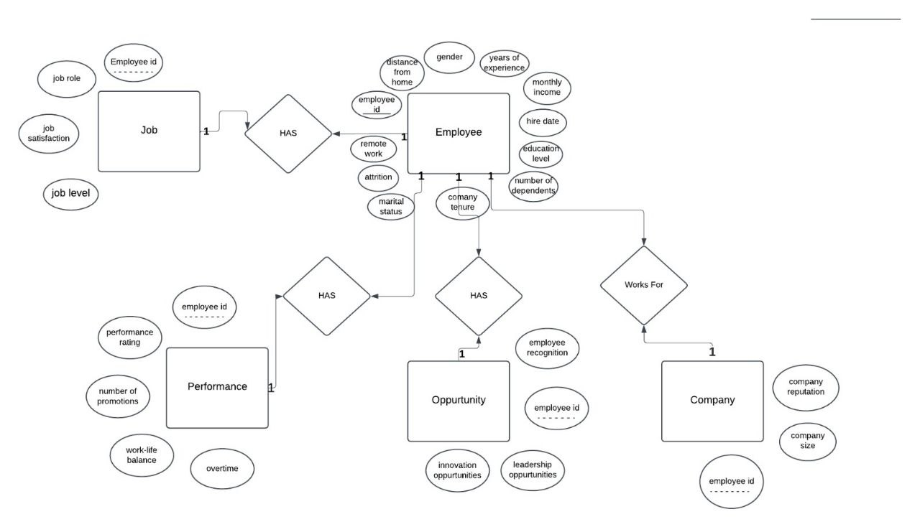
Relationships Between Entities (ERD)

Slide 11
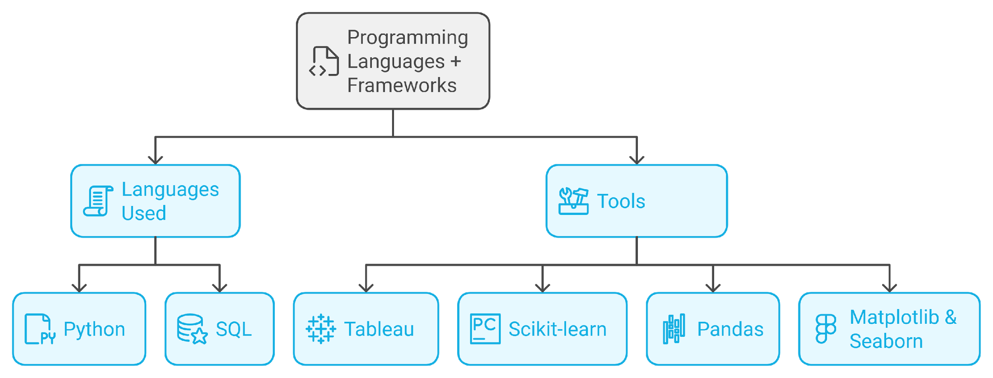
Programming Languages & Tools

Slide 12
Project Pipeline

Slide 13
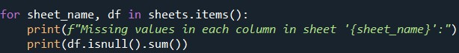
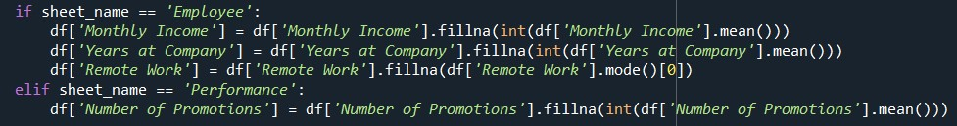
1- Data Cleaning
Fixing Data types
Detected missing values using df.isnull().sum()
Handling Missing Values
filled missing numerical values with mean to maintain data type consistency.
filled missing categorical values with mode to ensure correct data format.

Slide 14
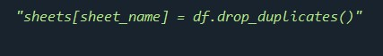
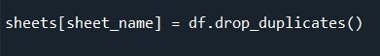
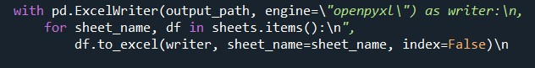
1- Data Cleaning
Removing Duplicates
Saving Cleaned Data

Slide 15
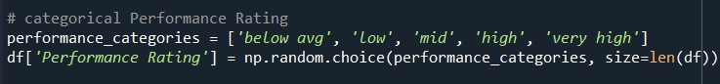
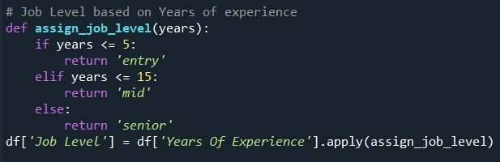
1- Data Cleaning
Generate Performance Rating
Generate Job Satisfaction Scores
Assign Job Level Based on Experience

Slide 16
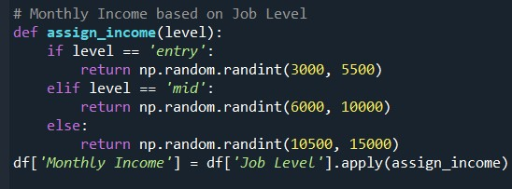
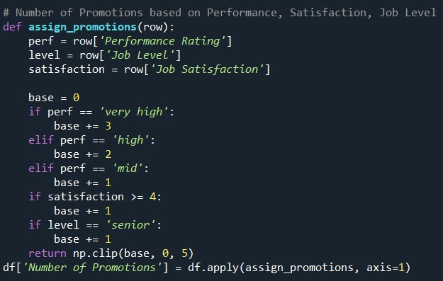
1- Data Cleaning
Generate Monthly Income
Calculate Number of Promotions

Slide 17
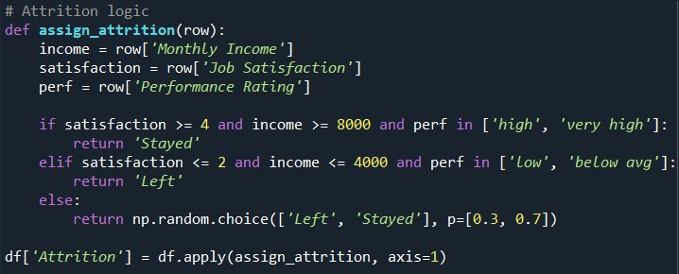
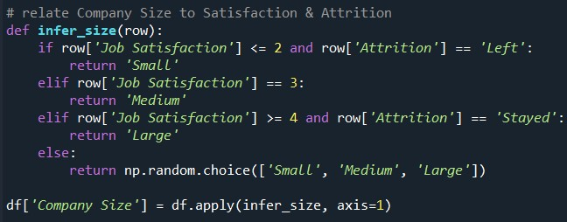
1- Data Cleaning
Determine Attrition
Inferring Company Size

Slide 18
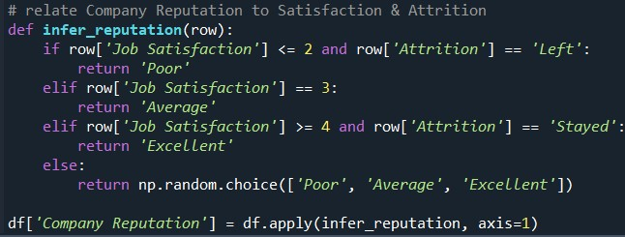
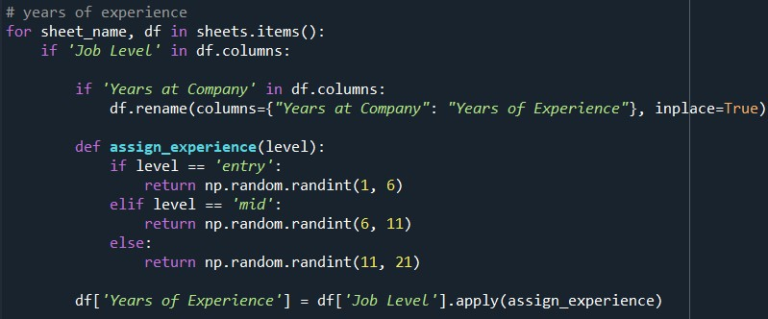
1- Data Cleaning
Inferring Company Reputation
Generate Experience

Slide 19
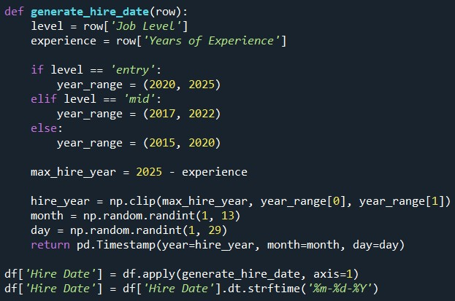
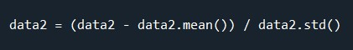
1- Data Cleaning
Generate Hire Date
Data Normalization

Slide 20
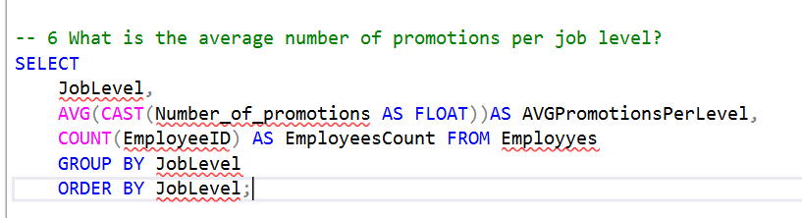
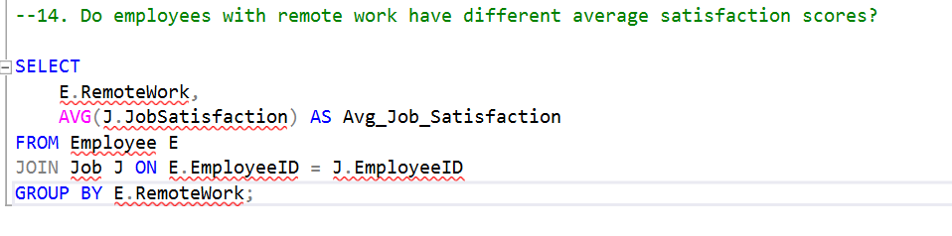
2- Data Exploratory Analysis (SQL)

Slide 21
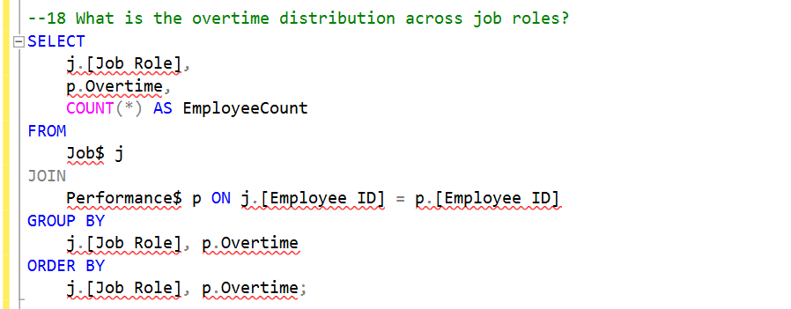
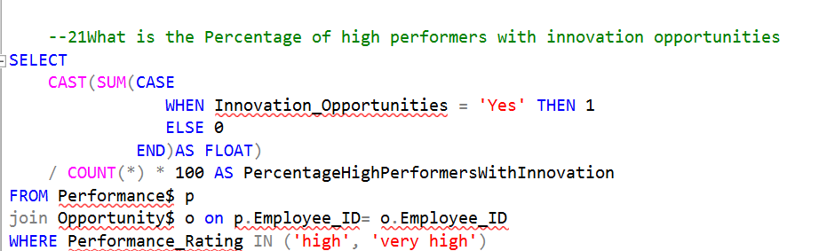
2- Data Exploratory Analysis (SQL)

Slide 22
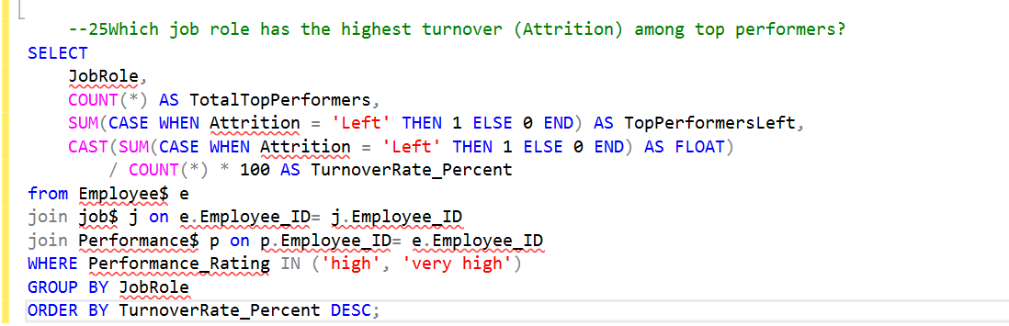
2- Data Exploratory Analysis (SQL)

Slide 23
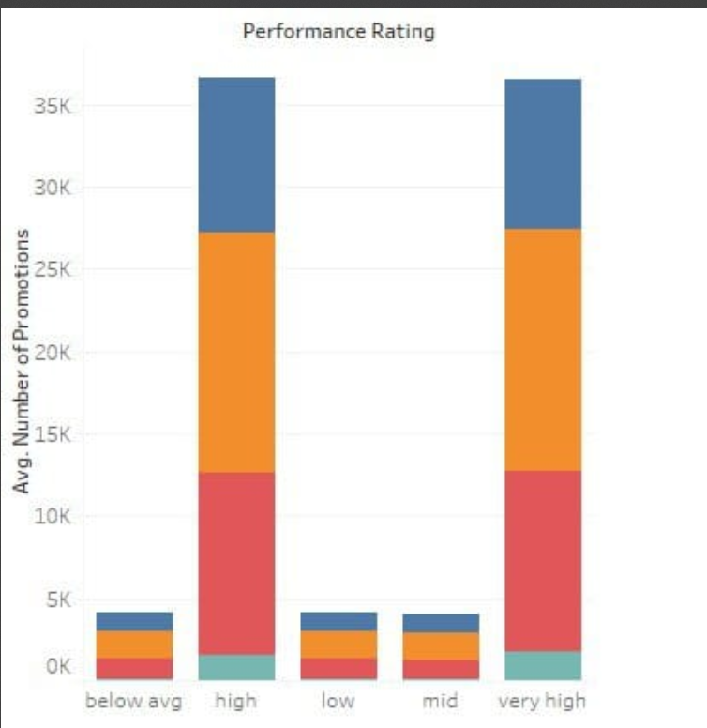
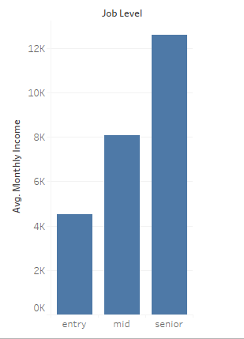
3- Data visualization (Tableau)

Slide 24
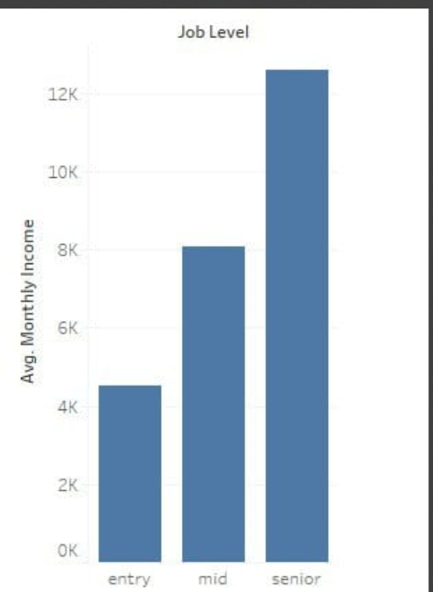
3. Data visualization (tableau)

Slide 25
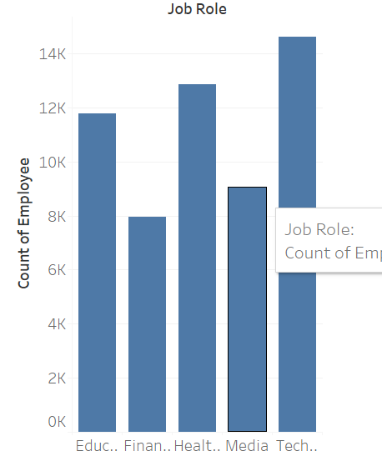
3. Data Visualization (tableau)

Slide 26
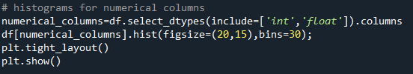
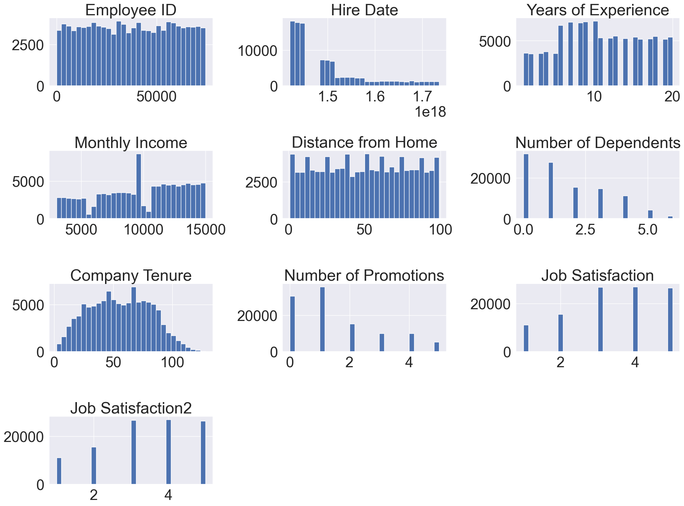
4- Data visualization (Python)
Visualize Distributions of Numerical Columns

Slide 27
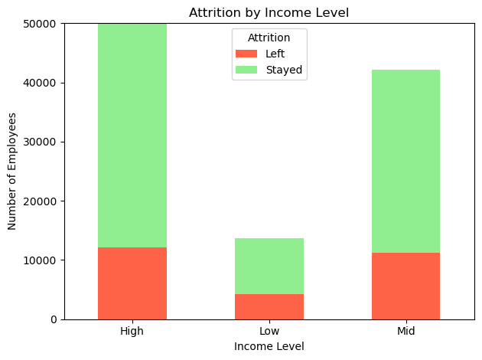
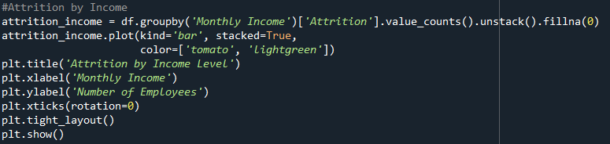
4- Data visualization (Python)
Distribution of Attrition by income

Slide 28
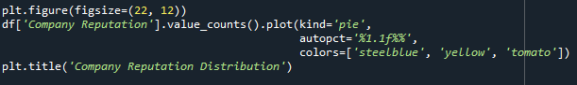
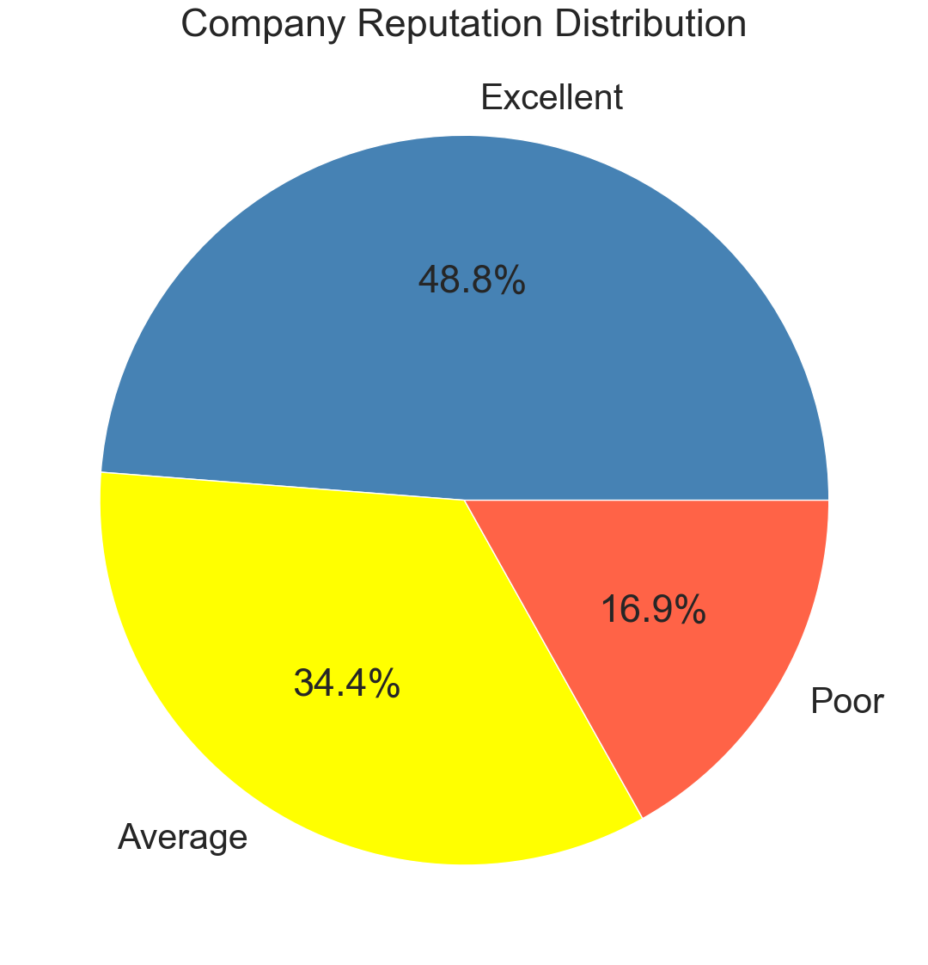
4- Data visualization (Python)
Distribution of company reputation

Slide 29
5- Model selection
Dataset Overview: contains exactly 56240 record.
Missing Data and Duplicates are Handled: Capped extreme values.
Modeling Approach:Gradient Boosting regressor model is used for regression and lightgbm is used for classification

Slide 30
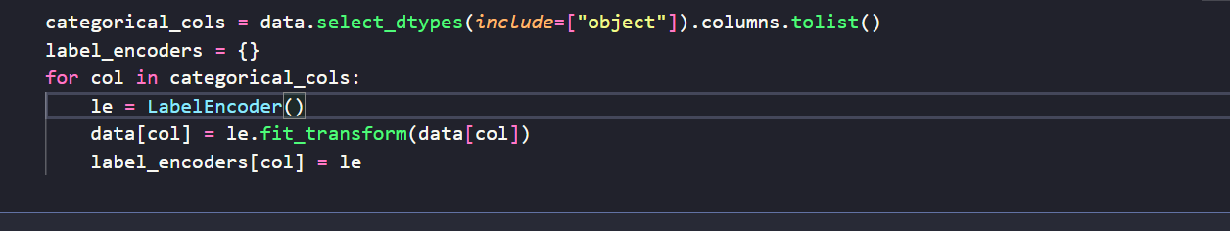
5- Model selection
Encoding Categorical Variables:
LabelEncoder for binary and ordinal variables (Gender, Donation Class, Training Category).
Target Encoding: LabelEncoder applied.

Slide 31
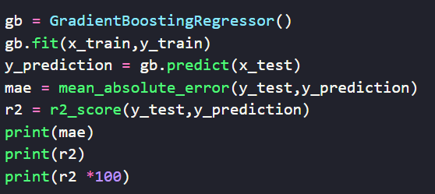
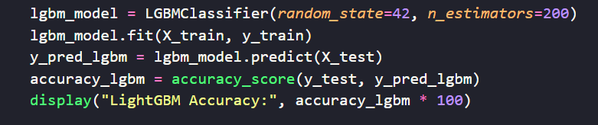
6- Model Building (Python)
Train-Test Split: 80% training, 20% testing.
Model Training: Achieved accuracy of 0.82 on test set for classification and 0.84

Slide 32
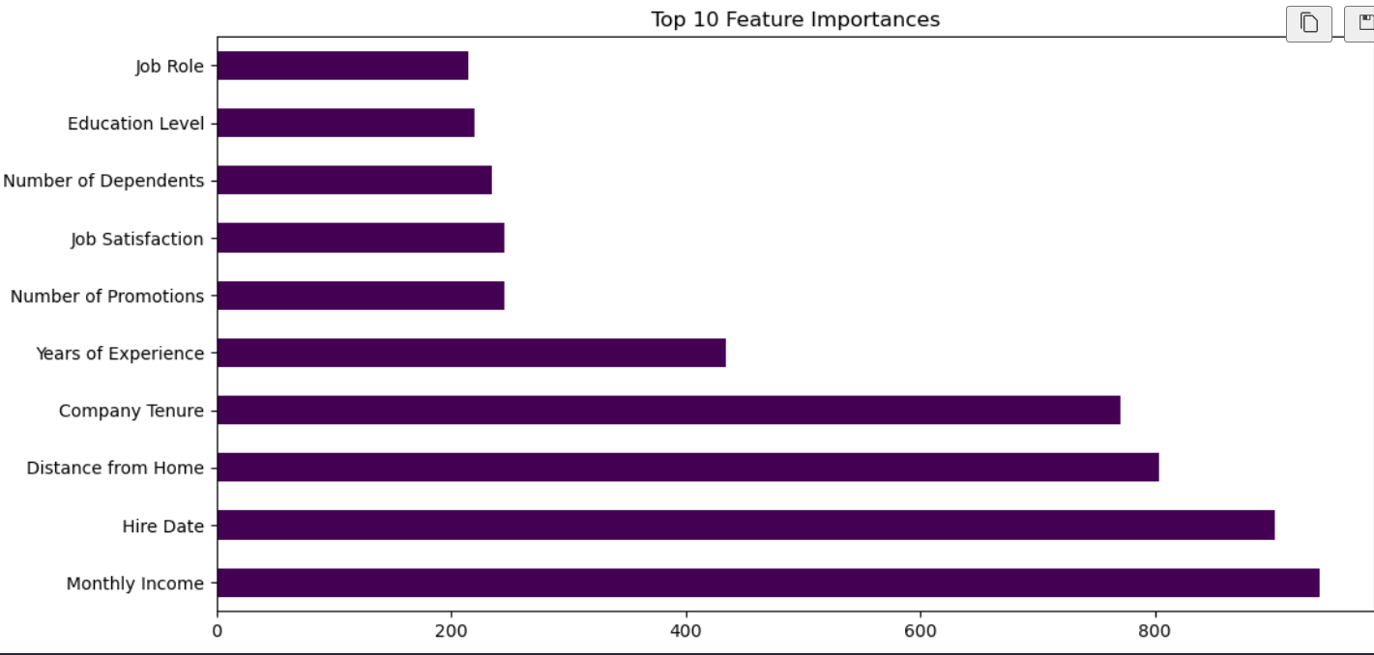
6- Model Building (Python)
Feature Importance: Top 10 important features selected in classification.
Model Re-training: Improved performance using important features.

Slide 33
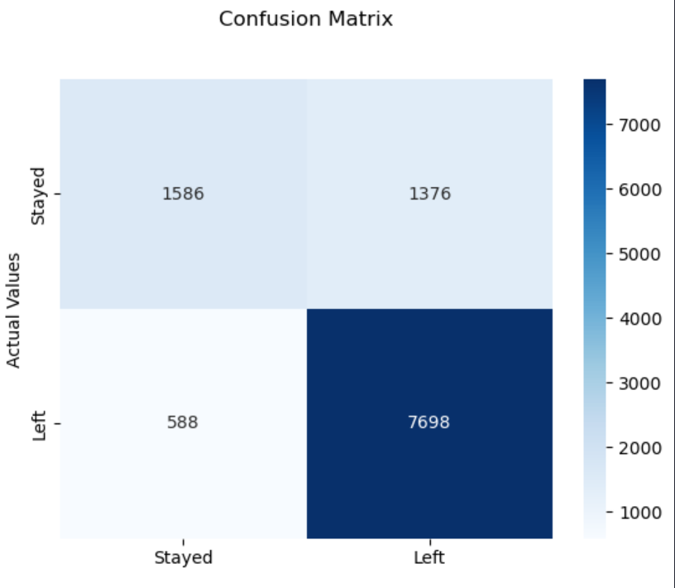
7.Machine visualization
Classification visualization:

Slide 34
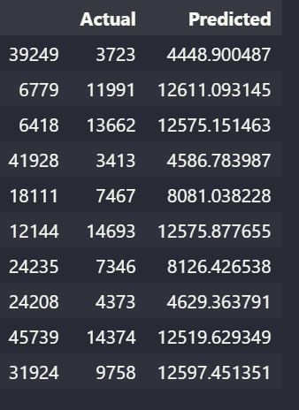
7.Machine visualization
Regression visualization:

Slide 35
Deliverables

Slide 36
Deliverables
Dataset (CSV file)
A comprehensive description that effectively communicates the details of your project.
A ZIP File containing Project Source Code. (Python, SQL)
A URL to dashboard after deployment. (Tableau public)
Project Documentation (project design, wireframe, model, visualizations, tutorials, report, etc.)

Slide 37
Milestones & Team Members

Slide 38
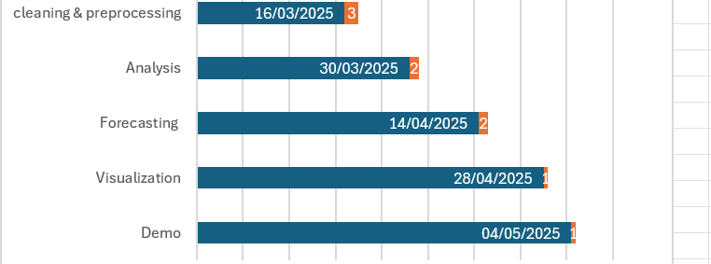
Project Timetable

Slide 39
Team members & Roles
We are following an Agile approach, where the entire team collaborates on the same milestone, this ensures flexibility and continuous improvement
Sara Ahmed
Habiba Mohamed
Mariam Mohamed
Marwa Ashraf
Salma Araby
Amina Osama

Slide 40

For Any Further Information please contact:
Sara Ahmed
01011904043

